Slide 1

Amazon alexa review analysis
SUBMITTED BY
JISSMOL JOSE

Slide 2
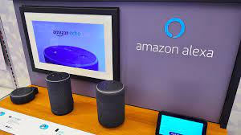
CONTENT
OBJECTIVE
INTRODUCTION
DATASET
ATTRIBUTES IN DATASET
TECHNOLOGIES USED
LIBRARIES AND PACKAGES USED
PLOTS USED IN VISUALIZATION
ALGORITHMS USED
ANALYSIS AND INTERPRETATION
VISUALIZATION
MODEL BUILDING
COMPARISON OF ALGORITHMS
APPLICATION
CHALLENGES
FUTURE ENHANCEMENT
CONCLUSION

Slide 3

OBJECTIVES
The objective of this project is to develop a machine learning system that can accurately analyze customers reviews of Amazon Alexa products and services, with the goal of improving customer satisfaction and identifying areas for improvement.
The system will use natural language processing techniques to extract and analyze text from reviews, and will use LSTM models to classify the reviews as positive or negative based on sentiment analysis.

Slide 4
INTRODUCTION
Amazon Alexa, also known simply as Alexa, is a virtual assistant technology that can also control several smart devices using itself as a home automation system.
As the use of Alexa continues to grow, customer reviews have become an important source of feedback for Amazon to improve their product and service offerings
In this project, we aim to develop a machine learning system that can analyze customer reviews of Amazon Alexa products and services using LSTM and NLP models.
The goal of our project is to improve customer satisfaction by providing accurate analysis of customer reviews, identifying areas for improvement in Amazon Alexa products and services, and providing insights for Amazon to make data-driven decisions.
We will also evaluate the accuracy of our models using different machine learning algorithms such as Logistic Regression, Random Forests, SVM,KNN,Naïve Bayers and compare the performance of these algorithms to determine the best approach for analyzing feedback for the reviews provided by the customers.

Slide 5

DATASET
Source:
Taken fron Kaggle website,actual source is amazon’s website
Number of observations:
3150(rows)
Number of attributes or variables:
5 (columns)

Slide 6
ATTRIBUTES IN DATASET
Rating: Numerical evaluation of users' satisfaction with the device.It falls between 1 and 5
Date: Analysis of changes in users' opinions of Alexa over time.
Variation: The variation attribute can be used to differentiate between different models of Alexa or other products in the same category. It has many variants which includes Black Dot, Charcoal Fabric, Configuration: Fire TV Stick, Black Plus, Black Show, Black, Black Spot, White Dot, Heather Gray Fabric, White Spot, White, Sandstone Fabric, White Show, White Plus, Oak Finish, Walnut Finish.
Verified_reviews: Provides insight into the experiences of users who have purchased and used Alexa which is a text
Feedback: The feedback attribute can provide additional information about users' experiences with Alexa, such as specific issues they encountered or features they particularly enjoyed.it says positive(1) and negative(0) review.0(rating 1 &2) and 1 (rating 3,4 &5).It is the dependent variable we used for classification

Slide 7

TECHNOLOGY USED

Slide 8
LIBRARIES & PACKAGES USED
emoji:It allows you to use and print emojis through a python program.
numpy: It will provide the support for efficient numerical computation.
pandas: It is convenient library that supports dataframes. Working with pandas will bring ease in many crucial data operations.
matplotlib: It provides a MATLAB-like plotting framework.
seaborn: It is a visualization library based on matplotlib which provides a high-level interface for drawing attractive statistical graphics.
sklearn: python library for data mining, data analysis and machine learning.

Slide 9
LIBRARIES & PACKAGES USED
re: Python has a built-in package called re, which can be used to work with Regular Expressions.
wordcloud: Word Cloud is a data visualization technique used for representing text data in which the size of each word indicates its frequency or importance.
nltk: The Natural Language Toolkit (NLTK) is a Python package for natural language processing. NLTK is one of the leading platforms for working with human language data and Python, the module NLTK is used for natural language processing.
TensorFlow: It is an open-source software library developed by Google Brain which allows developers to build and train machine learning models by creating computational graphs, which represent the operations that the model performs.
Keras: It is an open-source deep learning framework written in Python. It is designed to enable fast experimentation with deep neural networks, while also providing a user-friendly and modular API.

Slide 10
PLOTS USED IN VISUALIZATION
Countplot: A countplot is a type of bar chart that shows the count of observations in each category or bin, making it useful for visualizing the distribution of categorical data.
Piechart: A pie chart is a circular statistical graphic divided into slices to illustrate numerical proportions.
Barchart: A bar plot (or bar chart) is a graphical display of data using bars of different heights or lengths to represent values of a categorical variable, with the bars typically plotted vertically or horizontally.
Histogram: A histogram is a graphical representation of the distribution of a continuous numerical variable, using bars to represent the frequency of observations that fall into each interval (bin) of the variable's range.

Slide 11
PLOTS USED IN VISUALIZATION
Swarmplot:A swarmplot is a type of categorical scatterplot that displays individual data points as points or jittered points, avoiding overlap by automatically adjusting their positions in the horizontal direction.
Boxplot:A boxplot (or box-and-whisker plot) is a graphical display of the distribution of a continuous numerical variable based on five summary statistics: the minimum and maximum values, the lower and upper quartiles, and the median, represented by a box and two whiskers.
Wordcloud:A word cloud is a visual representation of text data that highlights the most frequent words by size and color, with larger and more prominent words indicating higher frequency of occurrence in the input text.

Slide 12
ALGOTITHMS USED
Random Forest Classifier
Logistic regression
Naive Bayes Classification(MultinomialNB &GaussianNB)
KNN (K Nearest Neighbors)
Support Vector Machine(SVM)
LSTM

Slide 13
Random forrest
It is a machine learning algorithm used for classification and regression It is an ensemble learning method that combines multiple decision trees to make a final prediction. The output of the random forest is then determined by taking the mode (in the case of classification) or the average (in the case of regression) of the predictions made by each individual tree.
Logistic Regression
Logistic regression algorithm is a statistical method used for binary classification problems, where the output variable is categorical and has discrete values. The outcome must be a categorical or discrete value. It can be either Yes or No, 0 or 1, true or False, etc. but instead of giving the exact value as 0 and 1, it gives the probabilistic values which lie between 0 and 1.
Naïve Bayes(MultinomialNB &GaussianNB)
Naive Bayes classifiers are a collection of classification algorithms based on Bayes‘ Theorem. To calculate the probability that an event will occur, given that another event has already occurred, we use Bayes‘ Theorem.
P(h|d)= (P(d|h) * P(h)) / P(d)

Slide 14
KNN (K Nearest Neighbors)
It uses the entire dataset as the training set, rather than splitting the dataset into a training set and test set. When an outcome is required for a new data instance, the KNN algorithm goes through the entire dataset to find the k-nearest instances to the new instance.
Support Vector Machine(SVM)
It is a supervised machine learning algorithm used for classification and regression analysis. It works by finding a hyperplane that separates different classes of data points in a high-dimensional space.
LSTM(Long Short term Memory)
This algorithm is a type of recurrent neural network (RNN) that is capable of learning long-term dependencies in sequential data by maintaining a memory cell and three types of gates - input gate, output gate, and forget gate.

Slide 15
ANALYSIS AND INTERPRETATION
Import Libraries
Data Cleaning & Preprocessing
Loaded the dataset using read_csv() function in pandas library
Check the shape, descriptive statistics, information, and null values.
After the data is described the following inferences are made.
There are total 3150 observations with 5 different feature variables/attributes present.
The average rating of the amazon Alexa product is 4.463. The minimum rating is 1 and the maximum rating is 5. The average feedback from the user is 0.9184 which is close to positive review

Slide 16
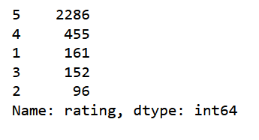

There is no null values in the dataset ,when checking missing values using isnull()
unique() function is used to check unique values in each column. Unique values for feedbacks is 0 &1
.dtype()function is used to check data types of each attributes.
A length column is appended to the data frame which contains the length of the corresponding review as its value. It is done for analyzing the length of the reviews.
Replace contractions on the dataset with word in contraction dictionary.
Find emojis & emoticons and replace it with some words. Eg.😍 replaced by Smiling_Face_With_Heart-Shaped_Eyes
The counts of the data according to the rating and feedback

Slide 17
LSTM (Data preprocessing and cleaning)
Convert the text to lowercase
Remove anything in square brackets using a regular expression pattern match
Remove all punctuation from the text using another regular expression pattern match
Remove any words containing digits using yet another regular expression pattern match
Remove certain characters such as hyphens, brackets, and quotes using a regular expression pattern match
Remove newline characters

Slide 18
VISUALIZATION
Data visualization aims to effectively communicate insights and patterns in large datasets to a broader audience, helping them make informed decisions and discover new insights.
These are a few popular libraries used in this project.
Matplotlib
Seaborn
Wordcloud

Slide 19
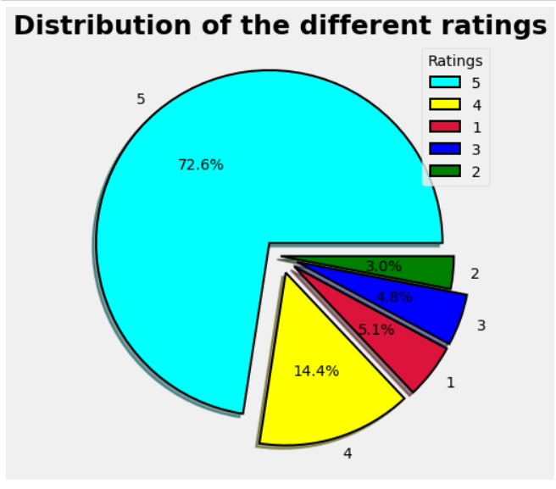
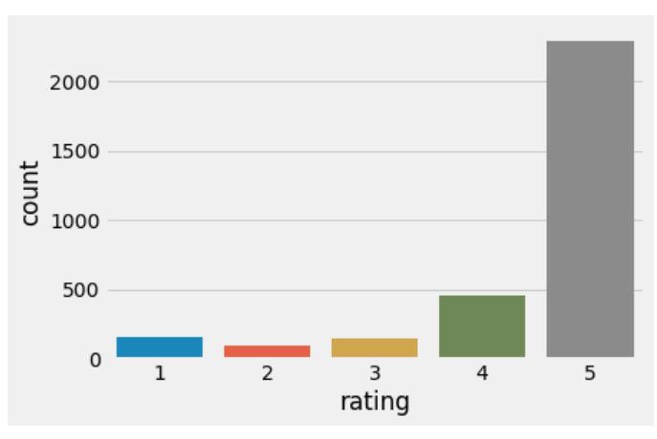
Distribution of Ratings for Alexa
Library: matplotlib and Seaborn
Plot used: pie chart and Countplot
Result:
Around 72.6% people have given Alexa 5 Star
14.4% people have given Alexa a 4 Star Rating, that means 72.6+14.4 = 87% people have given alexa good rating.
4.8% people have given alexa an average rating of 3 stars.
3.0% people did not like alexa and chose to give only 2 star ratings
5.1% people hated it and gave 1 star. This a total of 3.0+5.1= 8.1% people did not like alexa
Countplot shows that rating 5 have counts above 2000.More number of customers gives rating 5.
Both this plot gives as the same idea in different ways

Slide 20
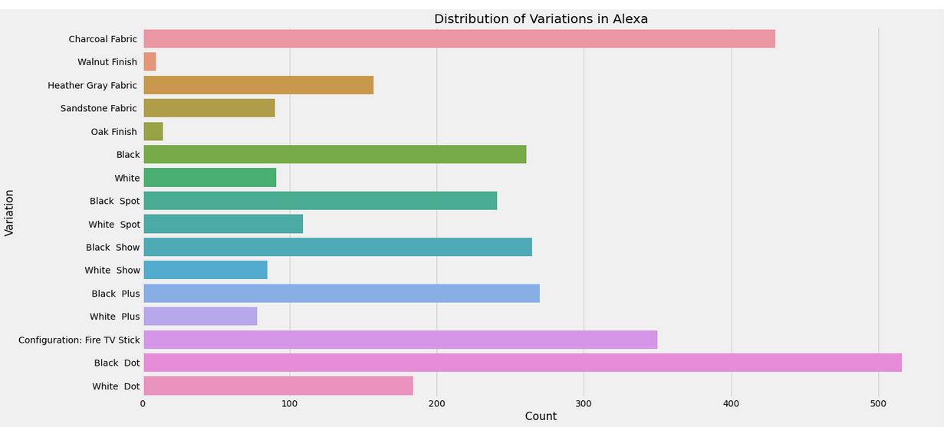
Distribution of Variations in Alexa
Library: matplotlib
Plot used: bar plot
Result:
Black Dot is the most popular variation of Amazon Alexa with more than 500 units .
Charcoal Fabric and Configuration: Fire TV Stick are also good and very much popular after Black dot.
Oak Fish and Walnut Finish are very less popular among customers

Slide 21
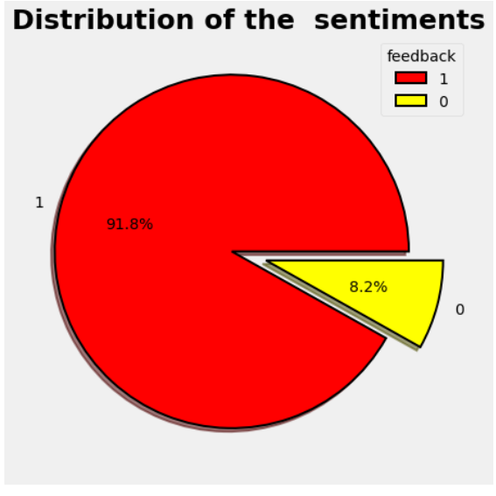
Distribution of feedbacks for Alexa
Library: Matplotlib
Plot used: pie chart
Result:
It says that around 91.8% people gave a positive feedback to Amazon Alexa and only 8.2% people gave negative feedback to Amazon Alexa.

Slide 22
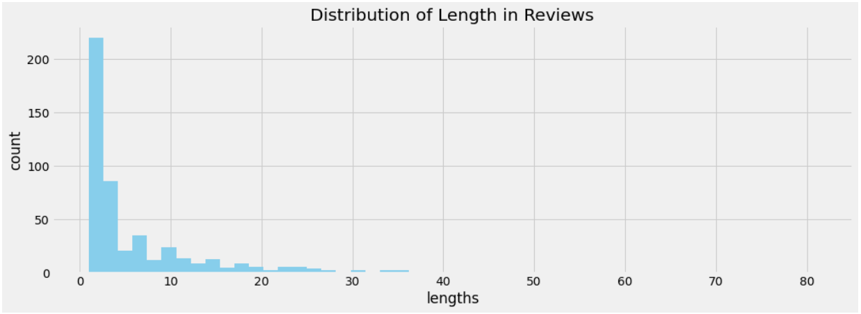
Distribution of lengths in reviews
Library: matplotlib
Plot used: histogram
Result:
Majority of the reviews from the customers are short. Most of the customers writes reviews that is 5-20 words longer. Very few peoples writes reviews of length above 20.

Slide 23
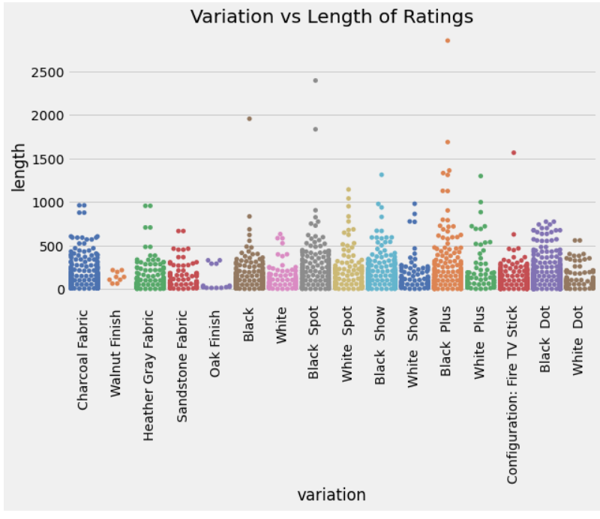
Variation vs Length of Ratings
Library: seaborn, matplotlib
Plot used: swarmplot
Result:
Longest review was written by the customer for Black plus.Walnut Finish and Oak Finish has reviews of less lenght because less customers used this variation. we might conclude that the longest reviews are all written for the Black-type variations in Amazon Alexa.eg,Black and Black spot

Slide 24
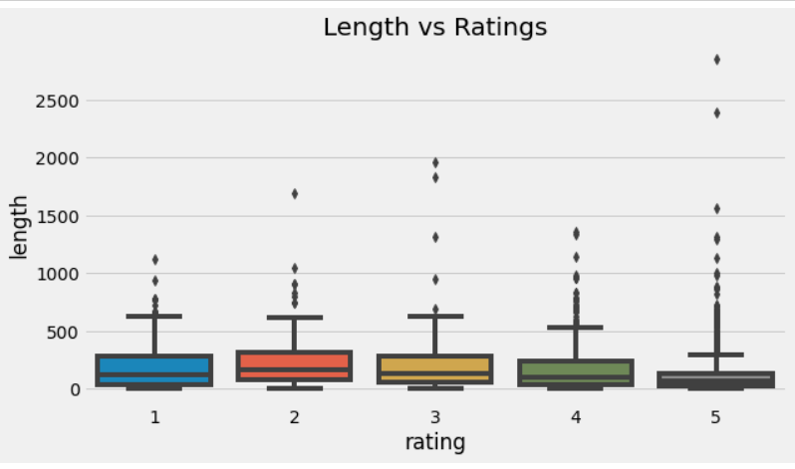
Length Vs Ratings
Library: seaborn, matplotlib
Plot used: boxplot
Result:
The longest reviews for Alexa were written by customers who provided a rating of 5.The number reviews for this rating is less.
Customers who gave Alexa a rating of 1 or 2 have written reviews of shorter length. Beacuse the users are not much satisfied with the product.

Slide 25
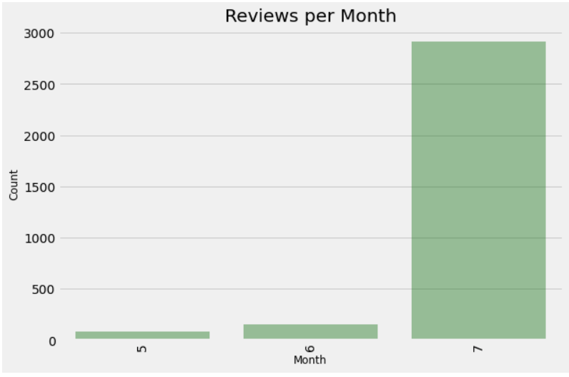
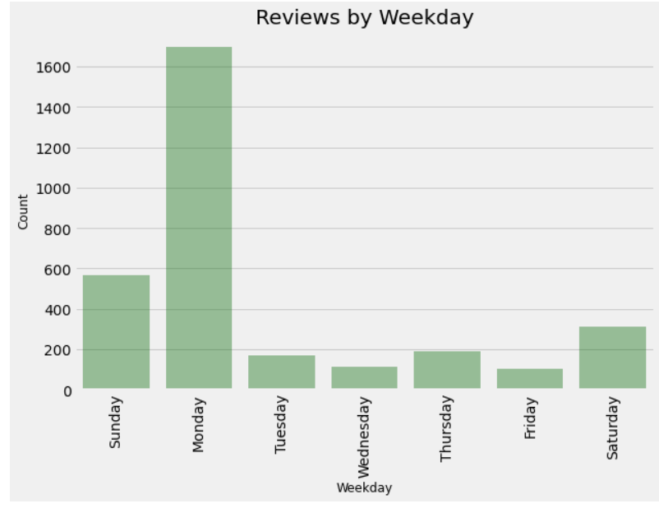
Library: seaborn, matplotlib Plot used: barplot
Reviews per month
Result:
It is seen that the dataset has more reviews from July.
Reviews by weekday
Result:
The number of reviews written is more on Mondays than any other days of the week.

Slide 26
Most frequently occurring words in positive and negative reviews
The sklearn.feature_extraction module can be used to extract features in a format supported by machine learning algorithms from datasets consisting of formats such as text and image.
The CountVectorizer provides a simple way to both tokenize a collection of text documents and build a vocabulary of known words, but also to encode new documents using that vocabulary.
The vocabulary is a collection of unique words from the input text data.
Significant textual data points can be highlighted using a word cloud.

Slide 27
Most frequently occurring words in positive and negative reviews
Using the class from the scikit-learn library in Python to convert text data into a matrix of token counts.
Creates an instance of the CountVectorizer class and remove English stop words from the text data.
Fits the CountVectorizer instance to the text data, which generates a vocabulary of unique words in the text data, and then transforms the text data into a matrix of token counts based on the vocabulary.
Result is a sparse matrix where each row corresponds to a document (in this case, a review) and each column corresponds to a unique word in the vocabulary
The values in the matrix represent the frequency of each word in each document.
There are list of tuples where each tuple contains a word from the vocabulary generated by the CountVectorizer instance and its corresponding total count across all documents (reviews) in the matrix which is converted to a dataframe for drawing bar graph

Slide 28
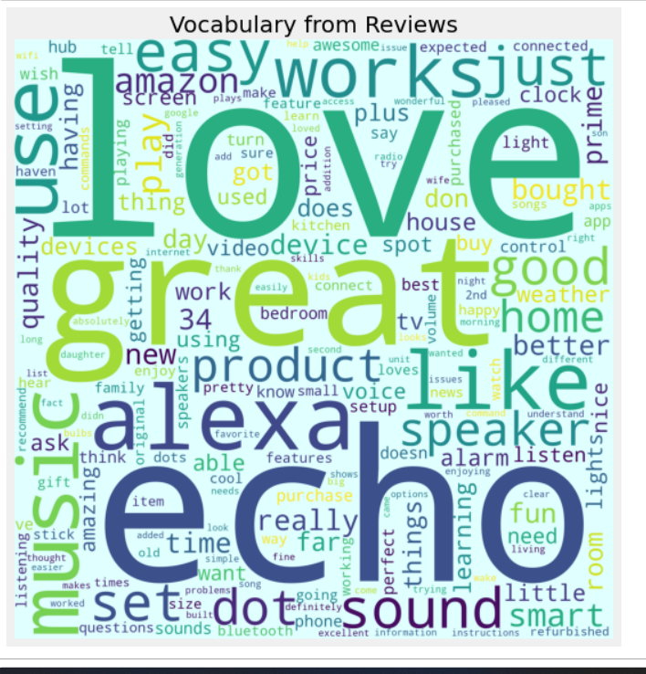
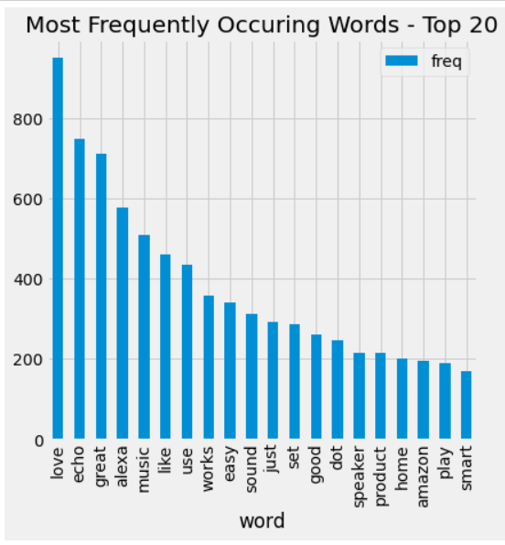
Library: matplotlib,Wordcloud
Plot used: barplot & wordcloud
Result:
Most frequently used word is love. Most of the customers likes Alexa products.
Other commonly used words in the review is echo,great and alexa which is also projected in the wordcloud .

Slide 29
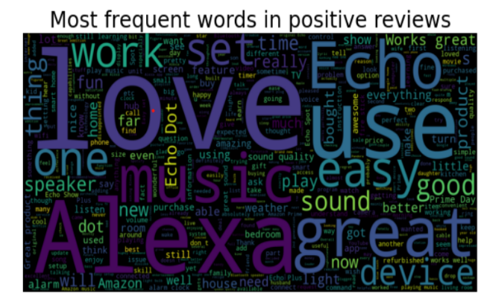
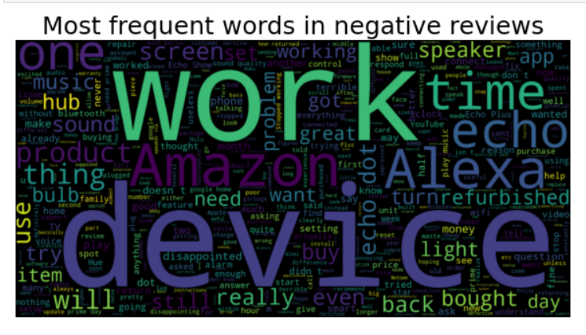
Most frequently occurring word in positive reviews are Love,Alexa,Great etc.Most of the people likes Alexa that is what we can understand from this wordcloud
Most frequently occurring word in negative reviews are work,device etc.

Slide 30
MODEL BUILDING
Before we build the model NLP is applied to the text reviews.
For natural language processing python‘s nltk (Natural Language ToolKit) is used.
Some NLP concepts used here include:
Stopwords
Corpus
Porter Stemmer

Slide 31
SPLITTING OF DATA
Removing characters that are not letters,covert text to lowercase ,stem using porter stemming appends the processed text to a list called 'corpus’.
x - 2-dimensional numpy array where each row corresponds to a document in the corpus and each column corresponds to a token in the vocabulary. The values in the matrix represent the count of the corresponding token in the corresponding document.
y-array which contain target values for each document in the corpus.(feedback column)
The train sets and test sets are made with 80-20 manner.
To normalize and scale the data, MinMaxScaler is applied
MinMaxScaler subtracts the minimum value in the feature and then divides by the range. The range is the difference between the original maximum and original minimum. The default range for the feature returned by MinMaxScaler is 0 to 1.

Slide 32
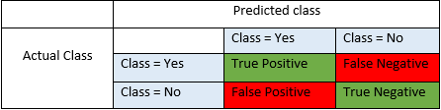
Building Classification Models
Before we go to model building let us go through some performance measures
True Positives (TP)
True Negatives (TN)
False Positives (FP)
False Negatives (FN)

Slide 33
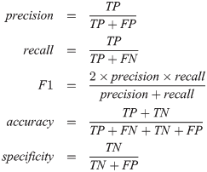
PERFORMANCE MEASURE
Accuracy - Accuracy is the most intuitive performance measure and it is simply a ratio of correctly predicted observation to the total observations.
Precision - Precision is the ratio of correctly predicted positive observations to the total predicted positive observations.
Recall (Sensitivity) - Recall is the ratio of correctly predicted positive observations to the all observations in actual class – yes
F1 Score - It is the weighted average of Precision and Recall. Therefore, this score takes both false positives and false negatives into account.
Specificity-It is also called true negative rate.The best specificity is 1.0 whereas the worst is 0.0

Slide 34
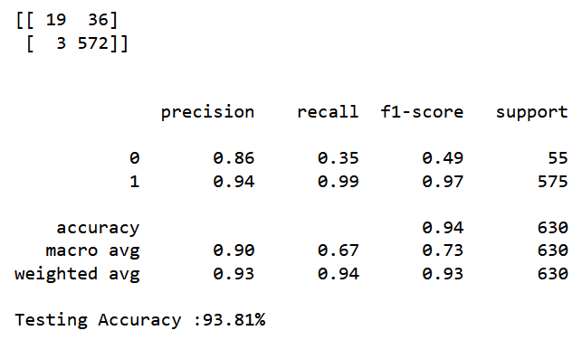
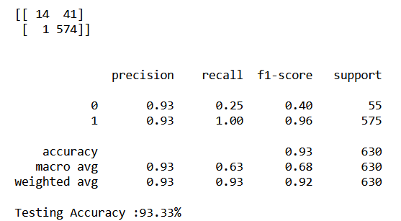
Random forrest classifier
Logistic Regression
from sklearn.ensemble import RandomForestClassifier
from sklearn.linear_model import LogisticRegression

Slide 35
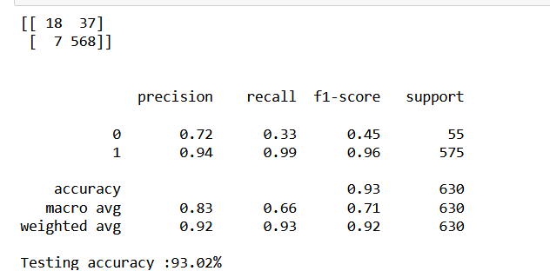
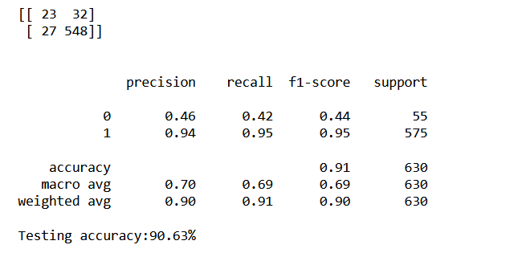
Naive Bayes Classifier
MultinomialNB
GaussianNB
from sklearn.naive_bayes import MultinomialNB
from sklearn.naive_bayes import GaussianNB

Slide 36
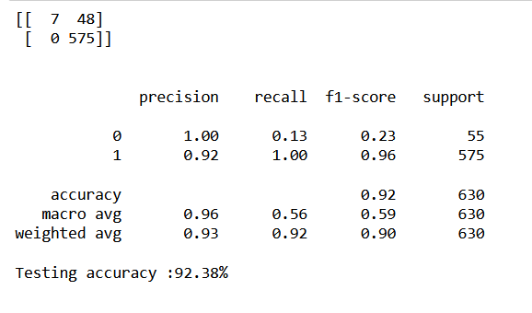
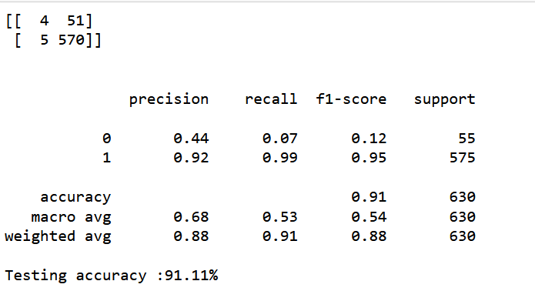
Support Vector Machine(SVM)
K Nearest Neighbors(KNN)
from sklearn.svm import SVC
from sklearn.neighbors import KNeighborsClassifier

Slide 37
Splitting of Data in LSTM
We used Keras Tokenizer class to tokenize the text data in the column of our dataset ('verified_reviews_clean' )
Keep only the 5000 most frequent words in your text data, and that you want to split the text into words based on spaces.
The fit_on_texts method is then called on the Tokenizer object to fit it to the text data .
The texts_to_sequences method is used to convert the text data in the column of the Dataset to sequences of integer values, where each integer corresponds to a specific word in the Tokenizer's word index.
The pad_sequences() function from Keras is used to ensure that all sequences have the same length, which is required for input to a neural network.
X will be a 2Darray where each row represent a sequence with a max length. Y is the feedback column

Slide 38
LSTM LAYERS
Used a sequential model in Keras for a text classification task using an embedding layer followed by an LSTM layer.
Embedding layer with vocabulary size ‘vocab_size,’embedding dimension’128’,and input length ‘maxlen’,This layer learns an embedding representation of each word in the input sequences.
SpatialDropout1D layer-This layer helps to regularize the model by randomly dropping out entire 1D feature maps in the embedding layer.
LSTM layer-This layer processes the sequence of word embeddings generated by the previous layers and outputs a fixed-length vector representation of the entire input sequence.
Flatten layer that flattens the output of the LSTM layer into a one-dimensional vector.
Dense layer with a single unit, followed by an activation function that outputs a probability value between 0 and 1 using a sigmoid activation function.

Slide 39
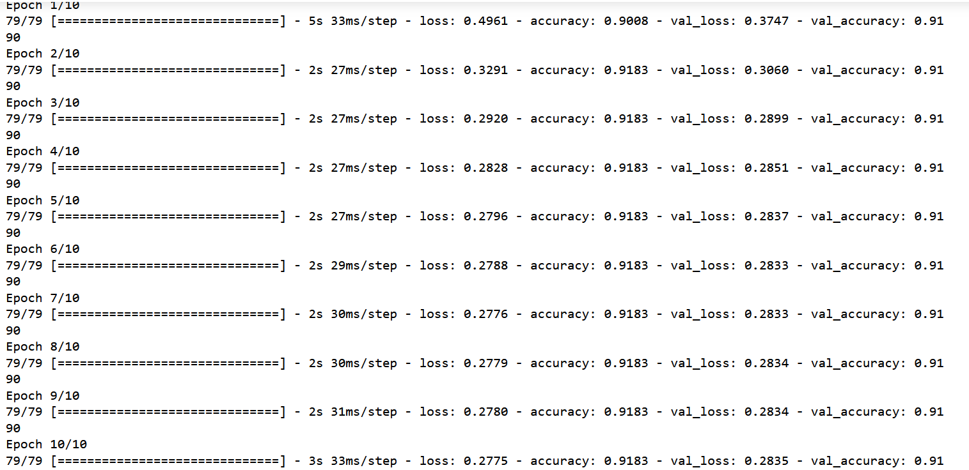
LSTM accuracy

Slide 40
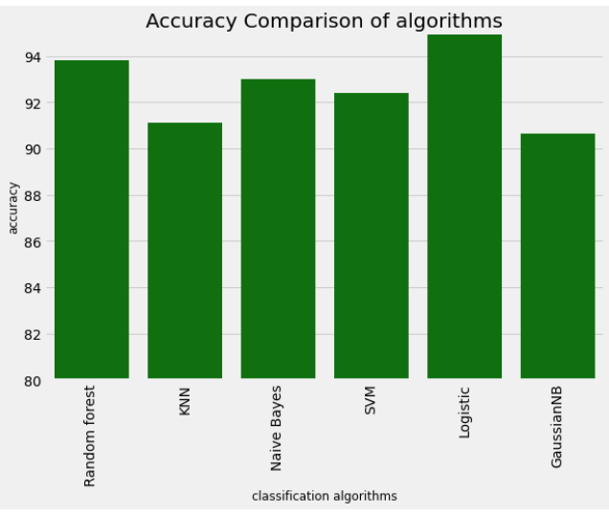
COMPARISON OF ALGORITHMS
Random Forest Classifier- 93.81%
Logistic regression -93.33%
Naïve Bayes Classification
Gaussian Naive Bayes-90.63%
Multinomial Naïve Bayes -93.02%
K Nearest Neighbors (KNN) -91.11%
Support Vector Machine (SVM) -92.38%
LSTM -91.9%

Slide 41
Choosing Model
GaussianNB (90.63%) with comparatively good accuracy is selected for the model building.Because this model give us a better prediction.
Prediction is done for new inputs.
LSTM model to give prediction for reviews in the dataset.

Slide 42
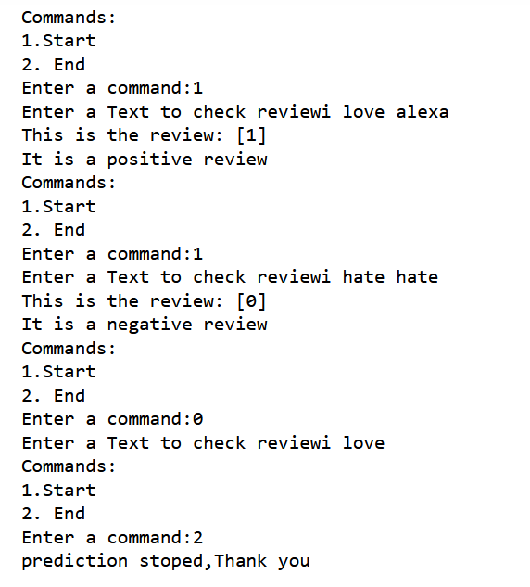
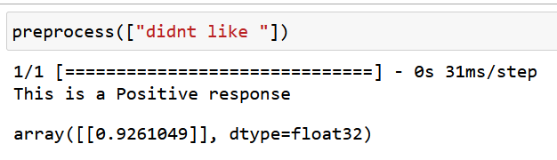
PREDICTION
USING GaussianNB
LSTM model

Slide 43
APPLICATIONS
Sentiment analysis: One application of the model could be to analyze the sentiment of customer reviews(positive or negative)of Amazon Alexa. This could be useful for companies to understand how customers are responding to their products, and to identify areas for improvement.
Feature extraction: The model could be used to identify the key features or aspects of Amazon Alexa that customers are most satisfied or dissatisfied with
Customer feedback analysis: The model could be used to track changes in customer sentiment over time, providing companies with valuable feedback on the effectiveness of changes made to the system
Competitor analysis: The model could be used to compare customer sentiment of Amazon Alexa with other similar products on the market.
Customer service: The model could be used to automatically classify incoming customer reviews or feedback and to direct them to the appropriate department for further action.

Slide 44
CHALLENGES
NLP and LSTM models may require different preprocessing steps.
These models may not take into account domain-specific knowledge, such as industry-specific terminology or slang.
However, the prediction accuracy may vary when the model is applied to new, unseen data.
The output of NLP and LSTM models may be difficult to interpret.
Dataset may be unbalanced, model may be biased towards the majority class.
Difficulty in choosing hyperparameters.
Memory and processing power.

Slide 45
FUTURE ENHANCEMENT
Personalized recommendations: By analyzing a user's review history and past interactions with Alexa, you could develop personalized recommendations for products and features that are most relevant to that user.
Real-time feedback: By analyzing reviews in real-time, you could provide instant feedback to Amazon on issues or concerns raised by users. This could help Amazon quickly identify and address issues with the Alexa device, improving customer satisfaction and retention.
Competitive analysis: By analyzing reviews of competing products and services, you could provide valuable insights to Amazon on how they compare to their competitors.
Predictive analytics: By analyzing patterns in user reviews and behavior, you could develop predictive models that forecast future trends and user needs.
Voice sentiment analysis: With the rise of voice assistants like Alexa, there is a growing need for sentiment analysis techniques that can analyze the sentiment behind spoken language.

Slide 46
CONCLUSION
As conclusion we can infer the following from the amazon alexa review analysis.
The average rating of the amazon alexa product is 4.463
Black Dot is the most popular variation of Amazon Alexa.
Charcoal Fabric and Configuration: Fire TV Stick are also good and very much popular after Black dot.
Oak Fish and Walnut Finish are very Unpopular
Around 92% people gave a positive feedback to Amazon Alexa and only 8% people gave negative feedback to Amazon Alexa.

Slide 47
CONCLUSION
Most people write reviews that is 5-20 words longer.
The longest reviews are all written for the Black type variations in Amazon Alexa.
In wordcloud we can see that love is the most frequent word in the word suggesting that most of the people absolutely love alexa.
LSTM is also good for prediction without losing the meaning of the sentence.But it have some limitation of the system.
A model is build using GaussianNB with accuracy 90.63% eventhough the accuracy is lower than other algorithm this algorithm gives the better prediction

Slide 48
THANK YOU

